Slide 1
LIQUID AND SOLID PROPULSION PROGRESS REPORT

Slide 2
FIRST WEEK’S OBJECTIVES
Create additional grains for the launch
Redesign the test stand
Acquaire material for the new design and machine it
Assemble the motors into the airframe
Acquiring new bolts for fastening the nozzle and bulk head
Pack up the grains into the motor and prep the ignition circuit
Dry run test
Static test

Slide 3
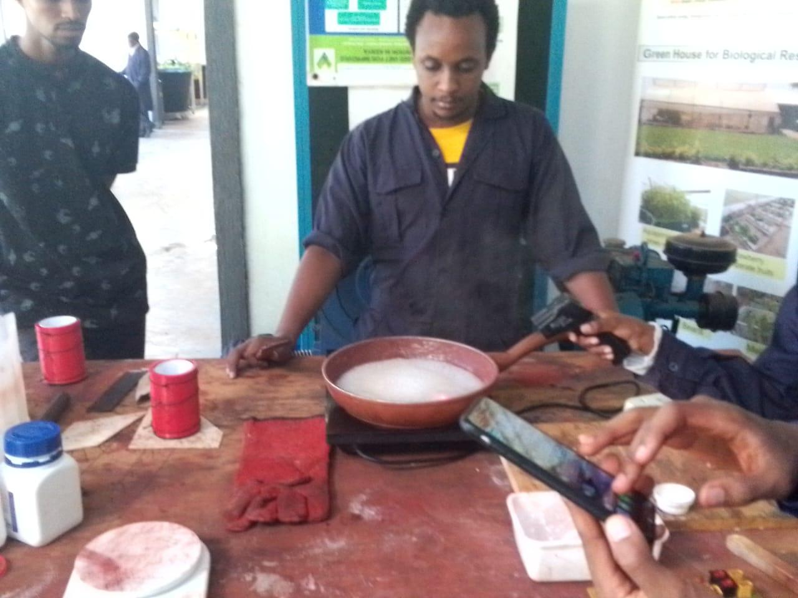
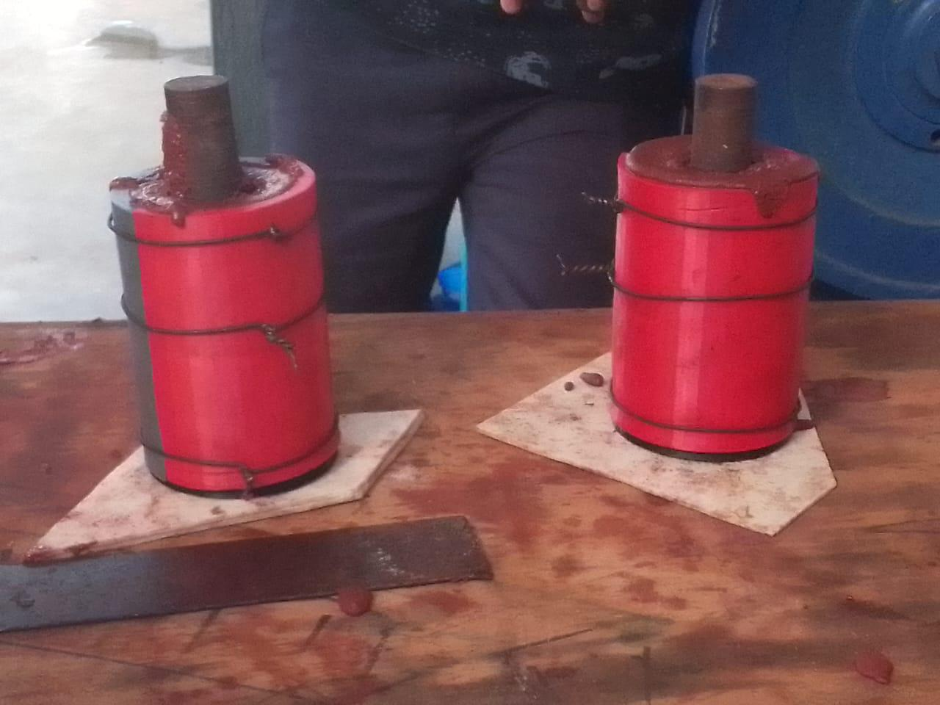
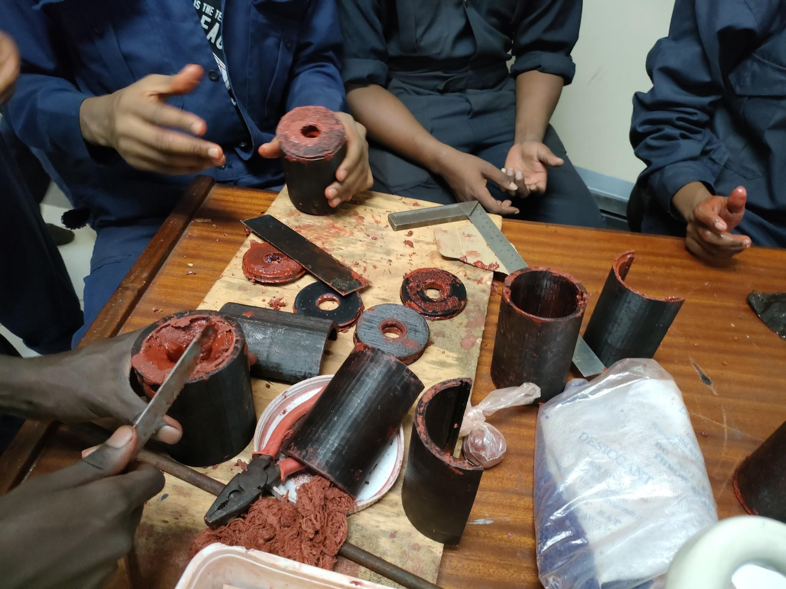
Task completed last week
Cooking enough grains for the launch

Slide 4
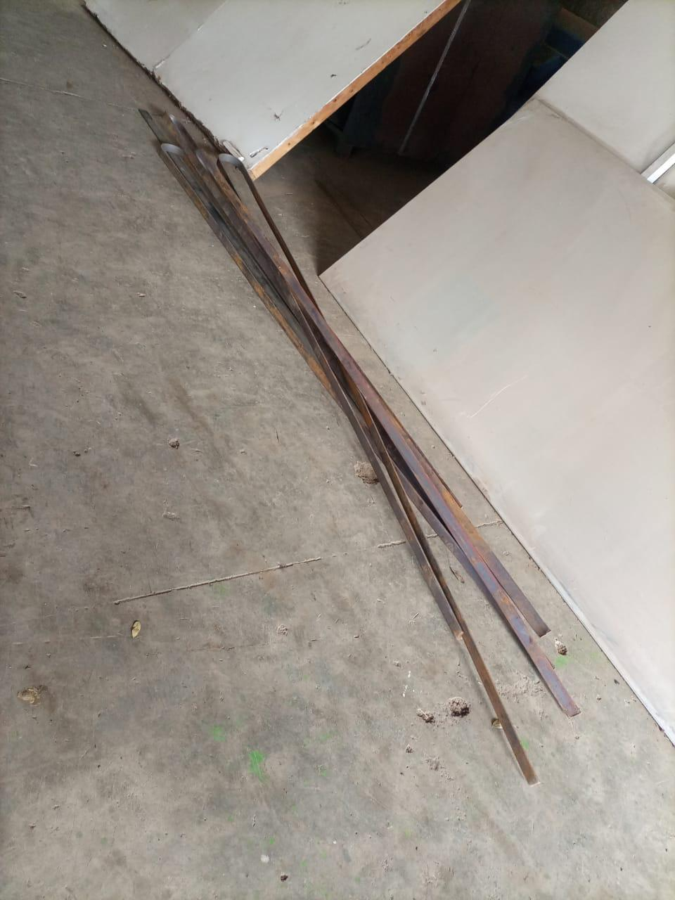
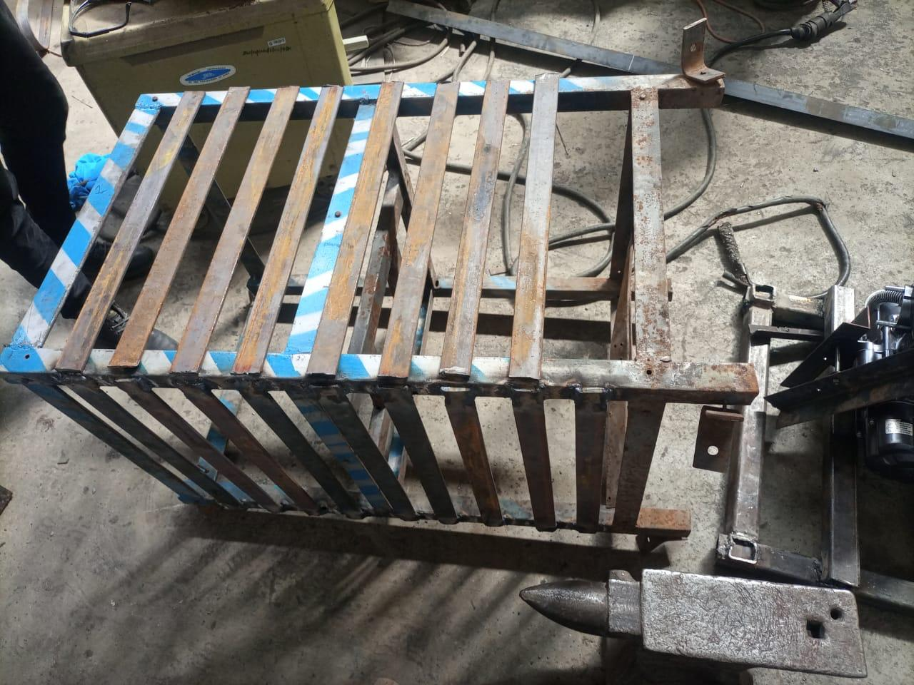
Acquiring materials to reinforce the test stand and fabricating it

Slide 5
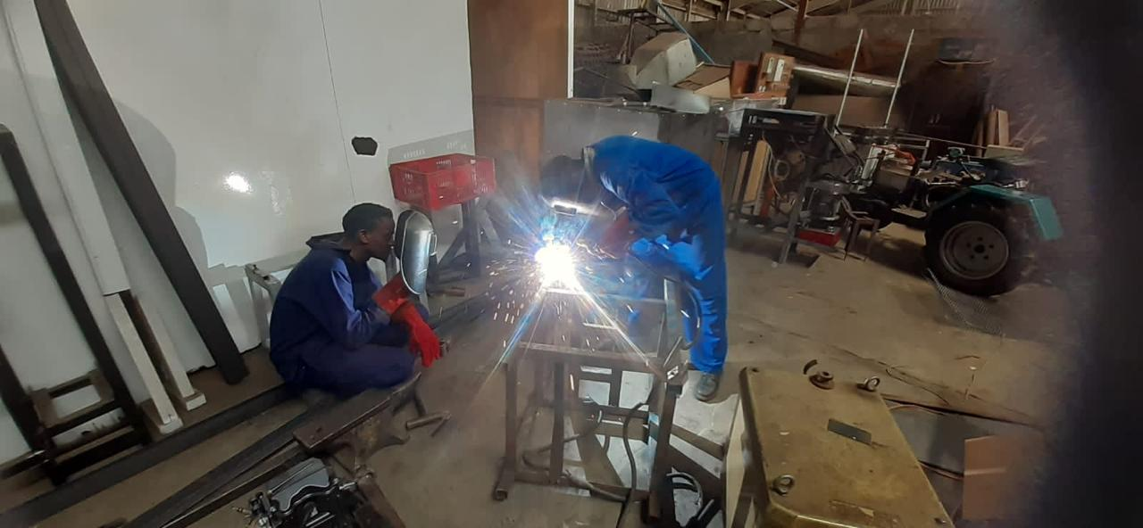
Acquiring 2 inch and 1.5 inch flat metal and wire gauze to reinforce the test stand.
Fabricating test stand

Slide 6
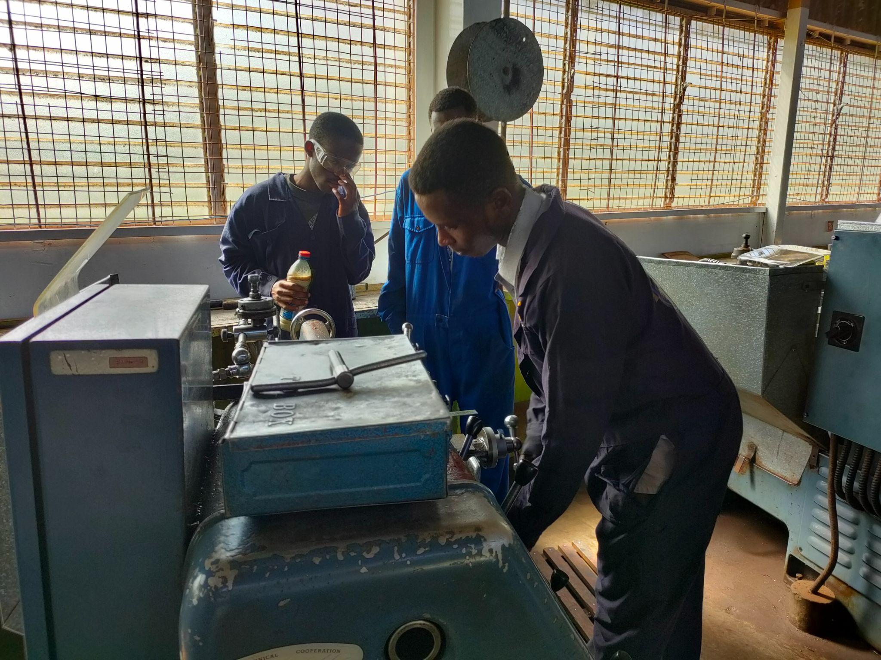
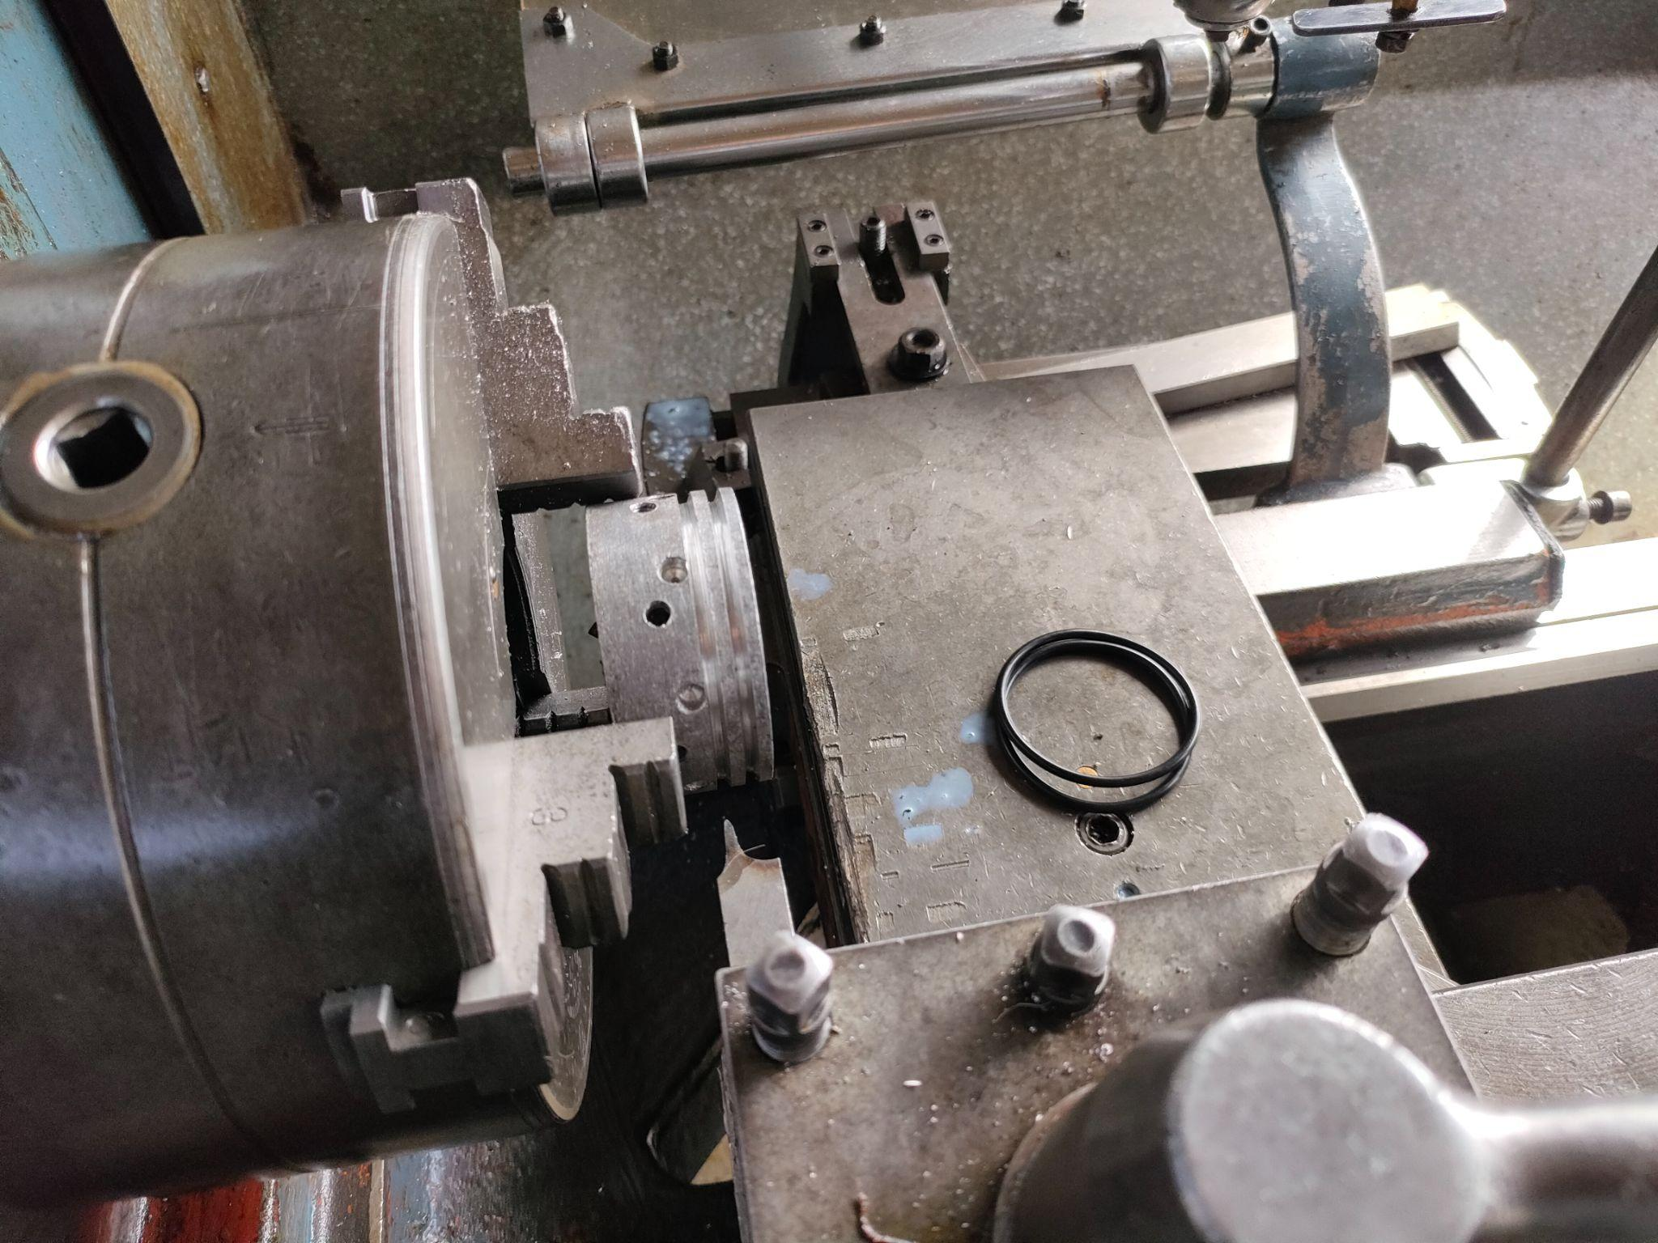
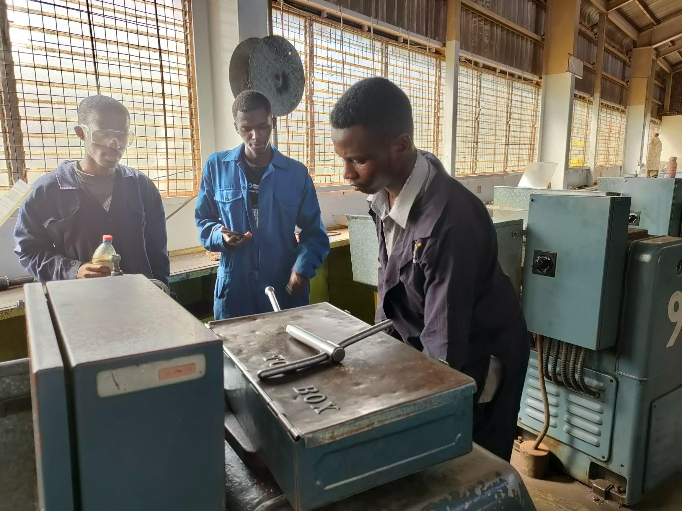
Increasing size of the O-ring grooves on the nozzle

Slide 7
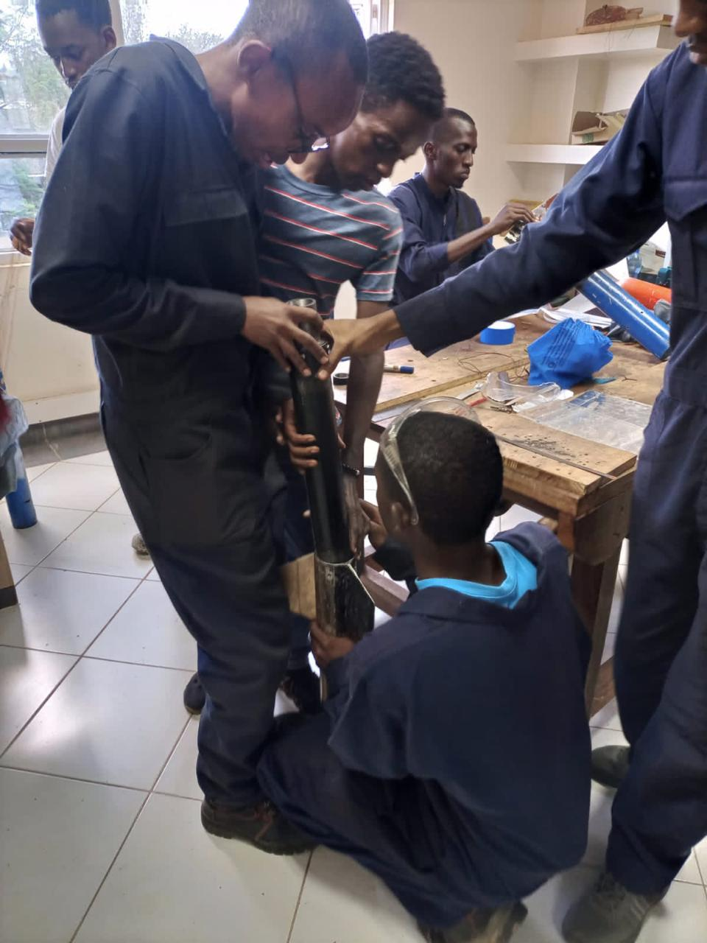
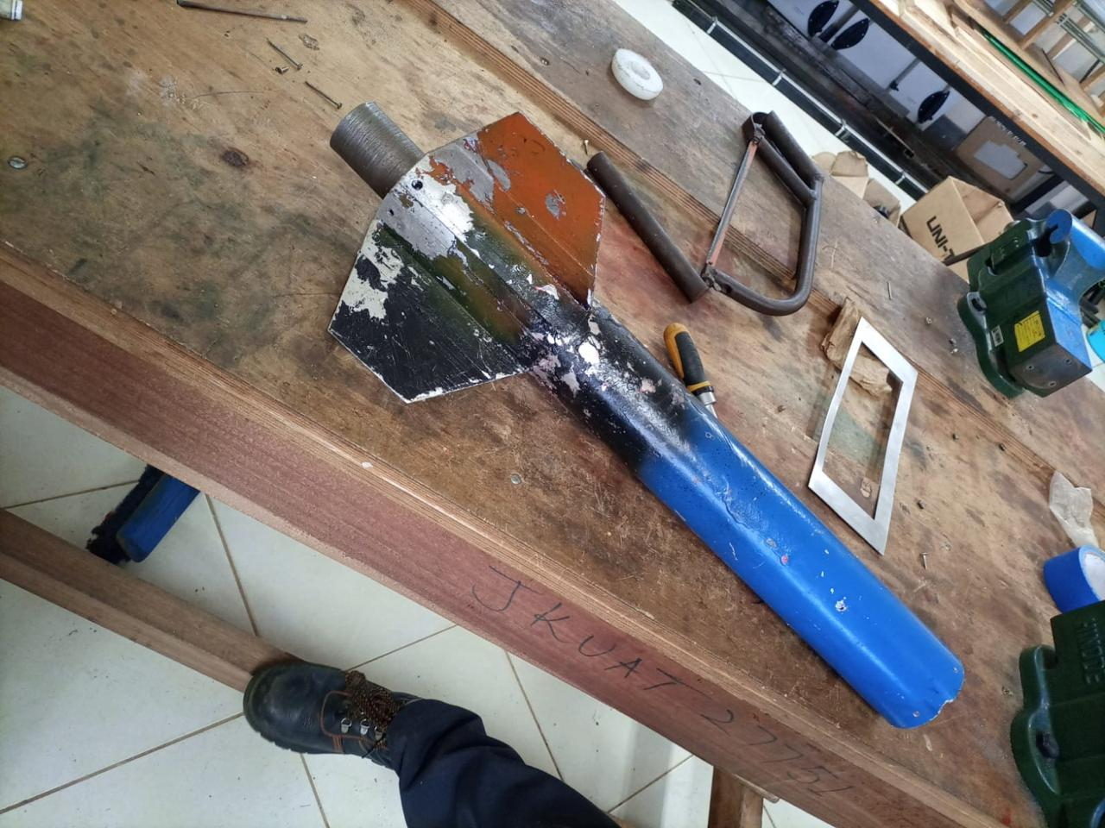
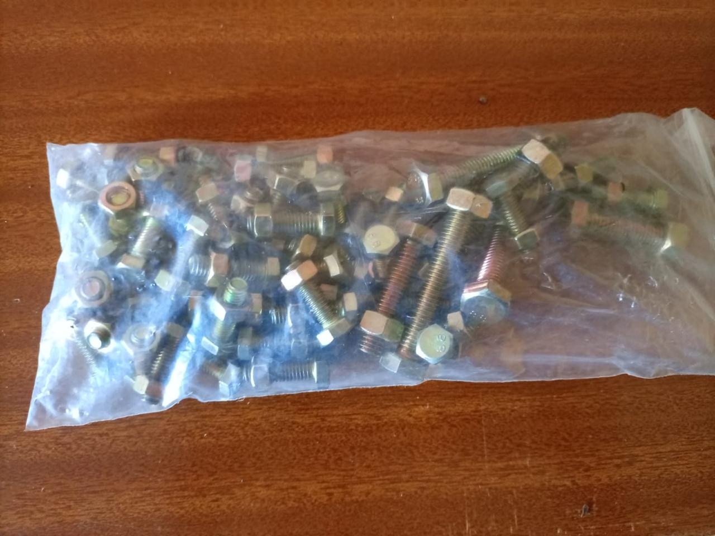
Acquiring new bolts and fastening them to the nozzle and the bulkhead.
Assembling the motors into the airframe

Slide 8
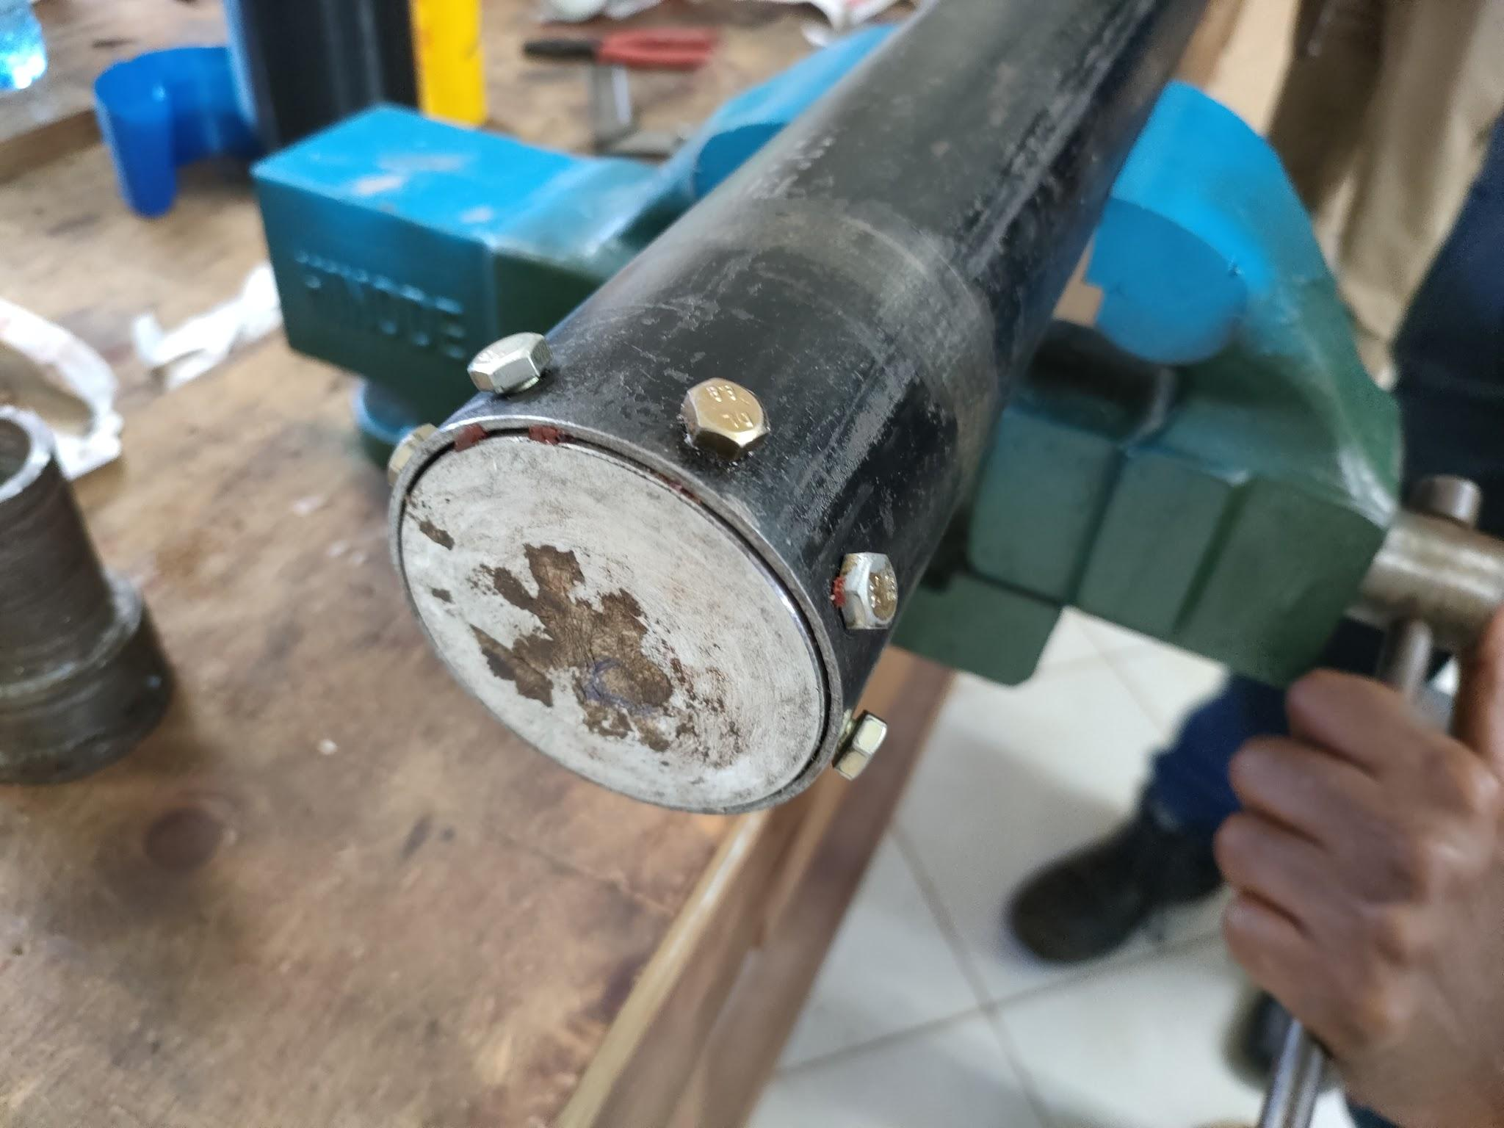
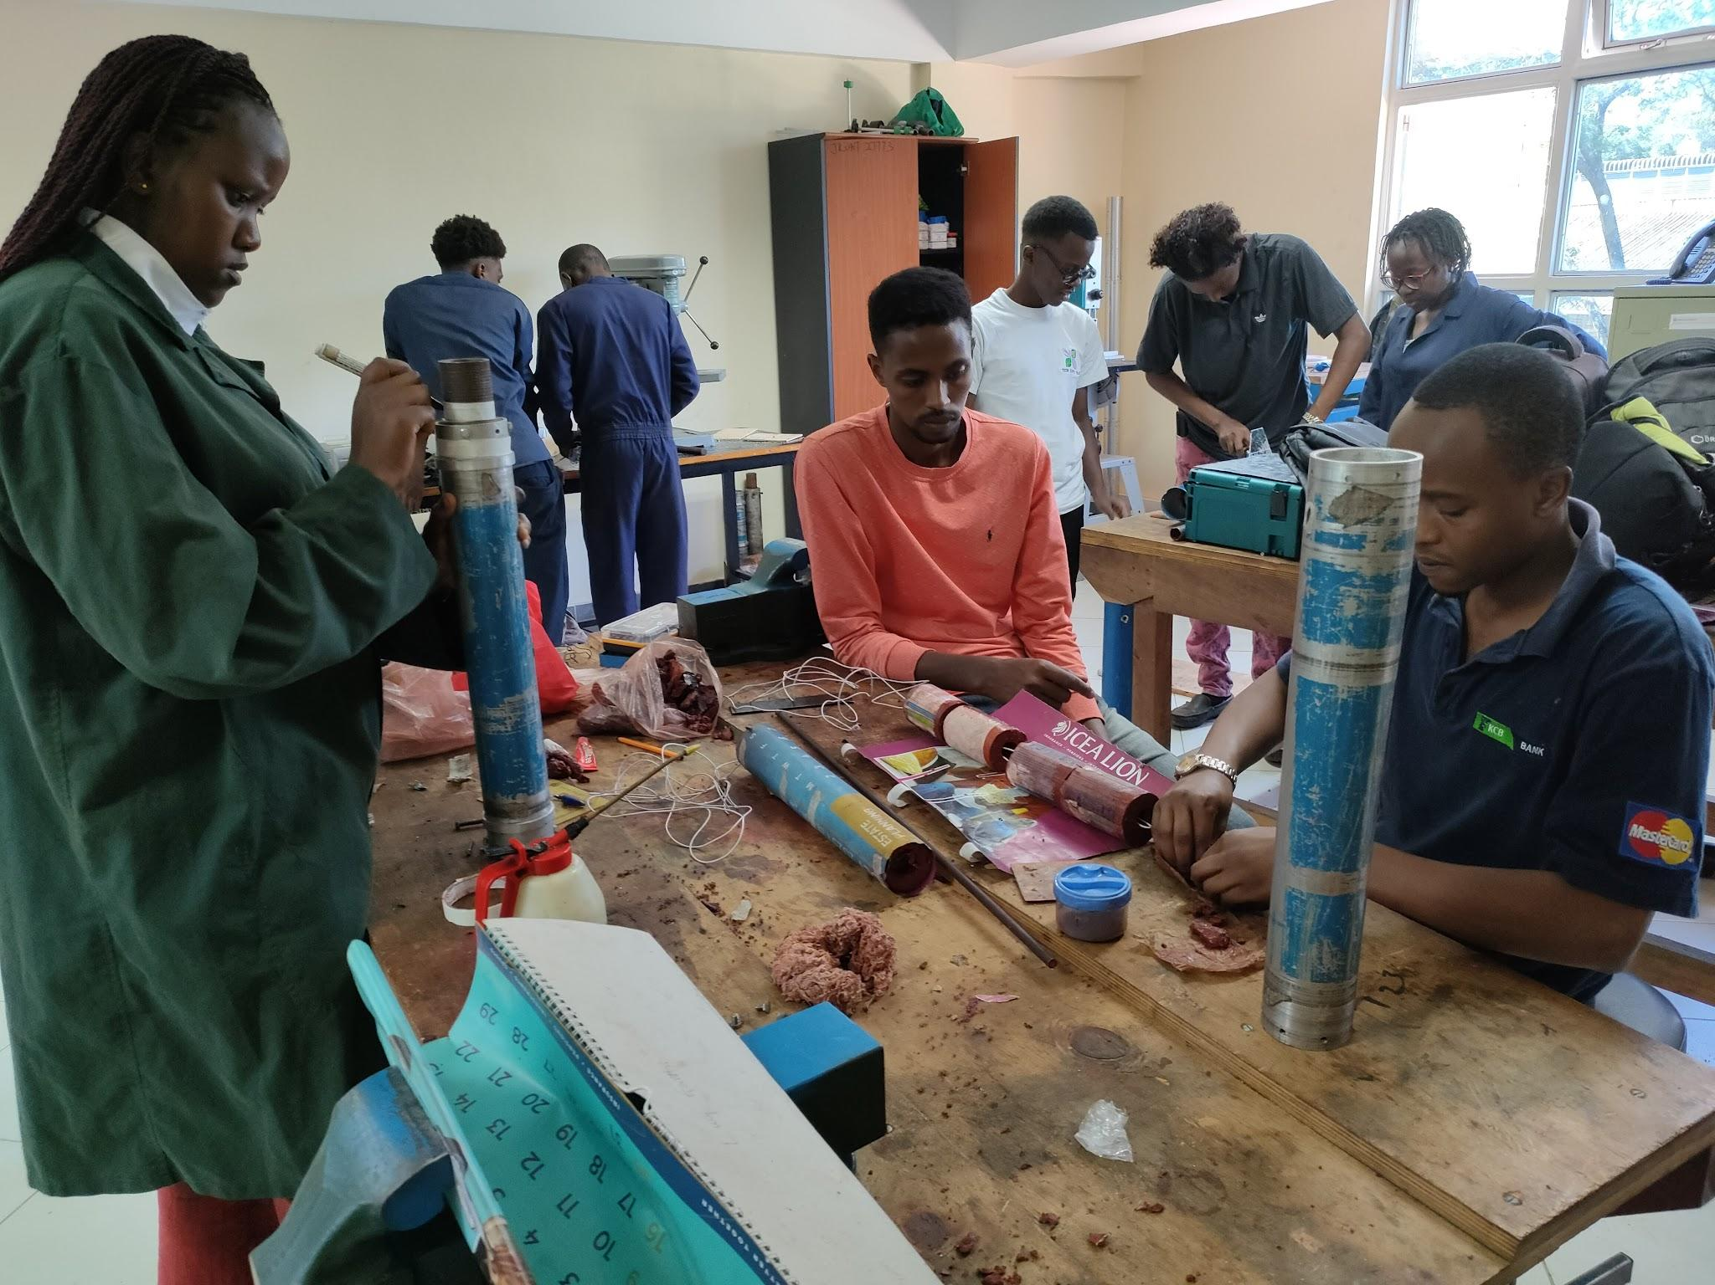
Assembling the motors into the airframe

Slide 9
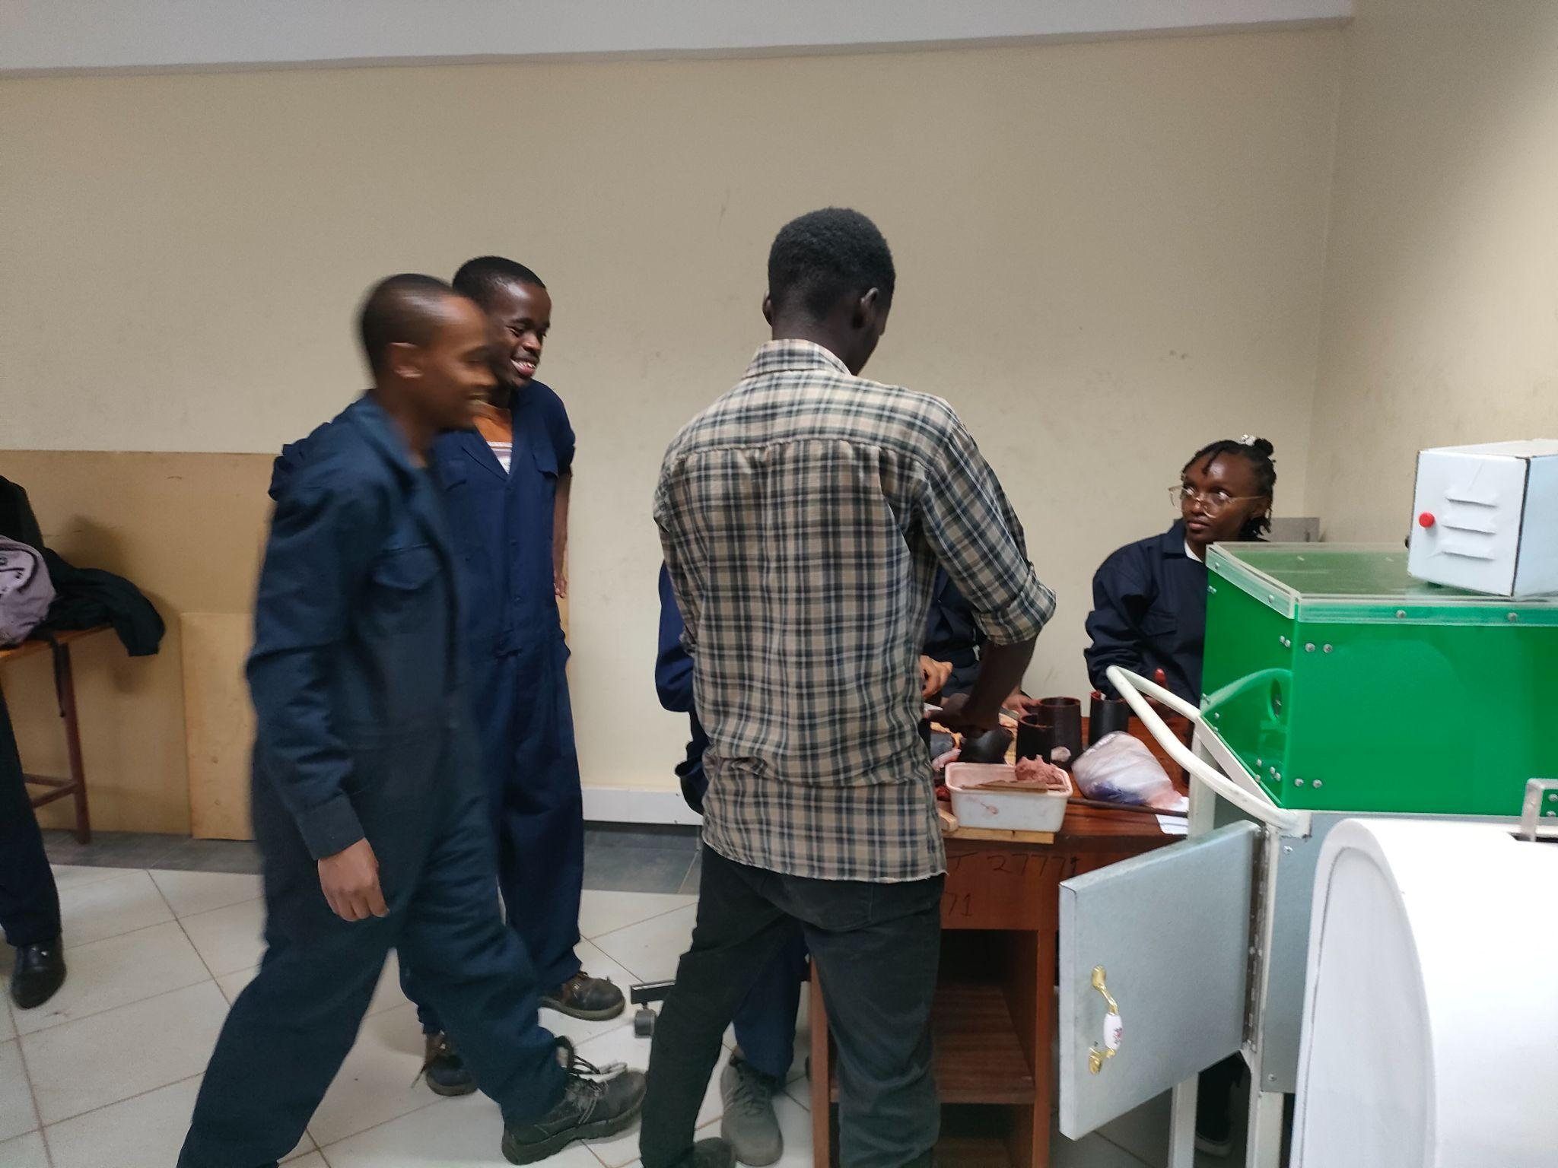
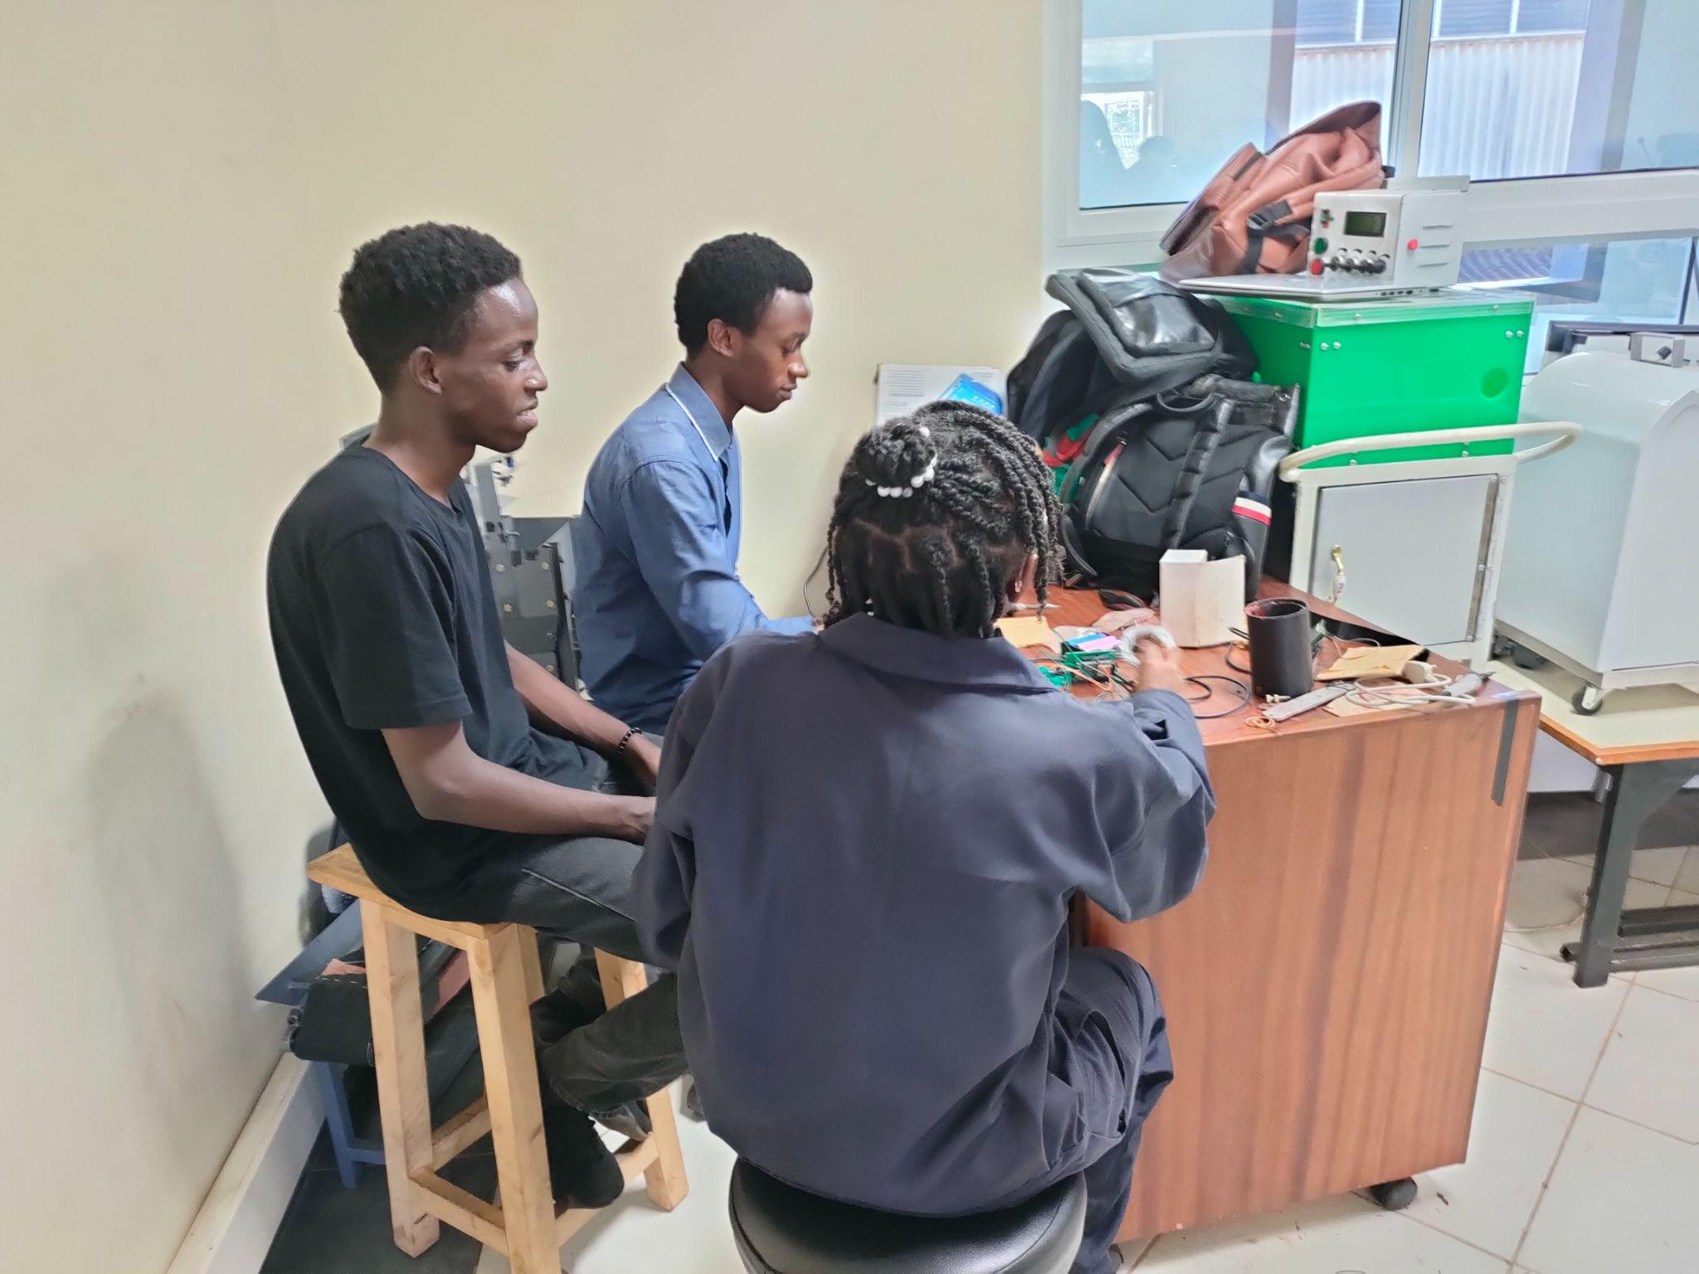
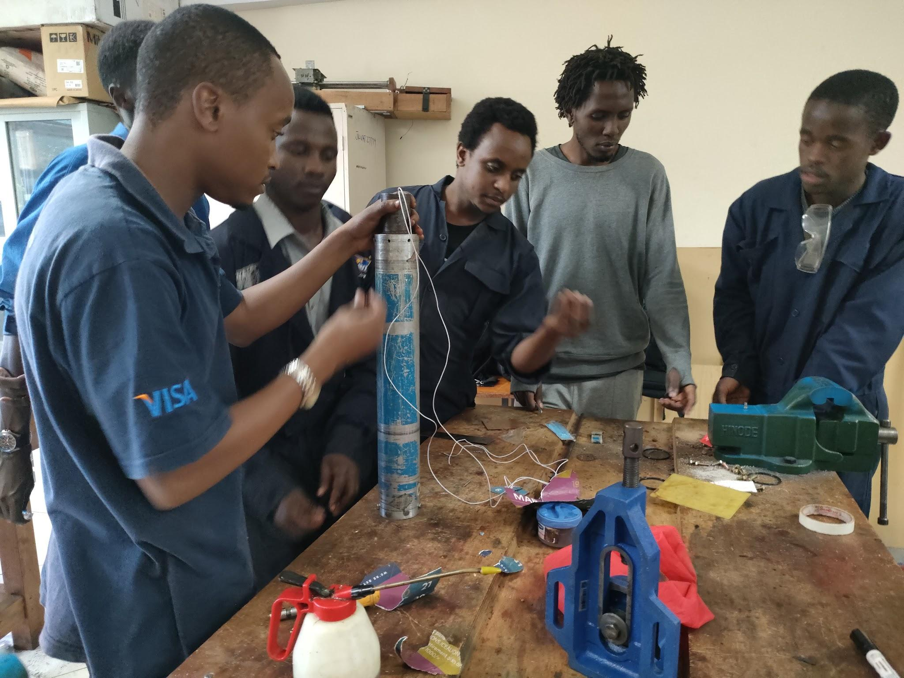
Ignition circuit assembly

Slide 10
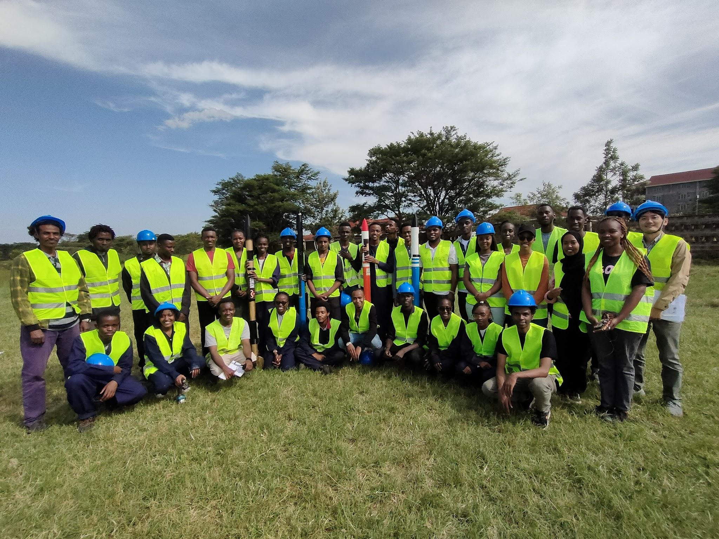
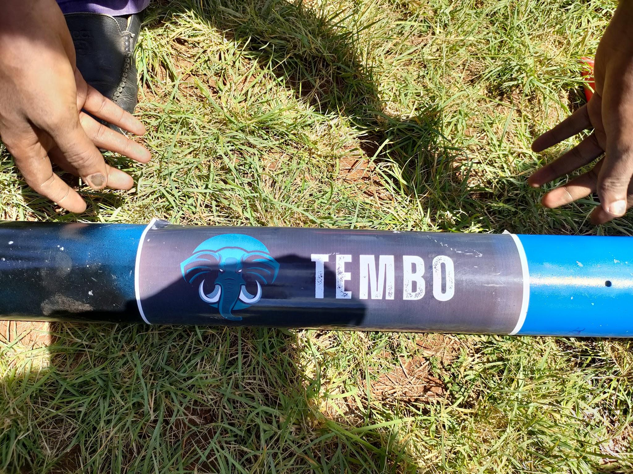
Dry run test

Slide 11
SECOND WEEK’S OBJECTIVES
Final assembly of the solid propulsion motor.
Launch.
Literature review on rocketry.
Inspecting launched rockets to identify their drawbacks.

Slide 12


Brainstorming

Slide 13
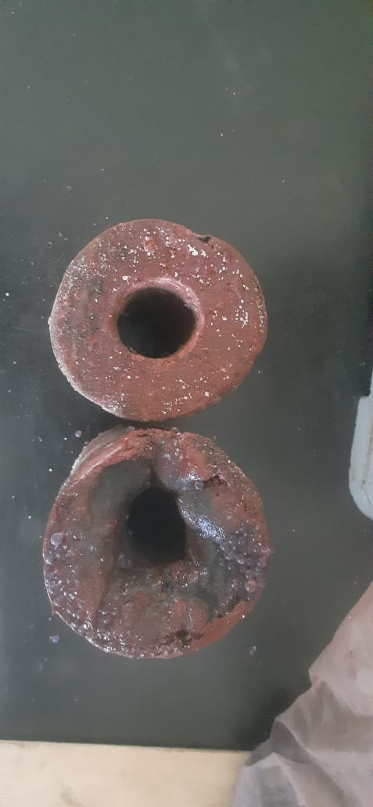
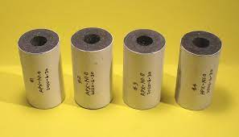
Tasks done.
Challenges and possible solutions discussed
Irregular shape of the grains - come up with new cast casing design.

Slide 14
Challenges and possible solutions discussed
Inaccurate KNSB mixing ratios. (65:35 or 64.4 : 34.6 : 1)
Misalignment of holes and poor nozzle securing design onto motor- change nozzle securing design
Ignition delay time - Reduce delay time using pyrogen igniter and grain combustion primer.
Weak bolts - Ensure use of steel bolts above class 8
Insufficient data
Uncontrolled burning -inhibting grains using epoxy, mylar, polyester( with cotton fabric)
Notes:
However, the segment ends are pretty much in a region of stagnant flow, and thus reliable ignition may pose a problem, regardless of igniter design. The use of a Combustion Primer may well be the solution. The Combustion Primer can be applied to certain surfaces of the propellant grain to ensure rapid ignition. For example, with a BATES grain, the segment ends would be coated, and the central core may be coated part way (near the segment ends).
As the coating is heated, the potassium nitrate melts readily (333ºC.), as no energy is absorbed by decomposition or melting of the "fuel" (charcoal) in the coating mixture, at this temperature. Only slightly further heating leads to the decomposition of the potassium nitrate (400ºC.), with the evolution of oxygen and subsequent combustion of the charcoal particles in the coating matrix.
Another factor that likely enhances the effectiveness of this Combustion Primer is the black colour. The high emissivity of the coating would facilitate radiant heat transfer from the flame.

Slide 15
Next Weeks Objectives(week 3)
Designing:
Motor casing
Nozzle
Bulkhead
Ignition circuit(previous circuit analysis and redesign)

Slide 16
Thank you.

